Slide 1
MARKET
Second lecture

Slide 2
Objectives of the topic
To understand differences among different market systems.
To understand peculiarities of monopoly, oligopoly and perfect competition.
To define marginal cost and marginal revenue

Slide 3
Classification of market structure
Perfect competition
Monopoly
Pure monopoly
Natural monopoly
Monopolistic competition
Oligopoly
Non-collusive oligopoly
Collusive oligopoly
Duopoly

Slide 4
Perfect Competition

Slide 5
Main characteristics of perfect competition
Market to be defined as ‘perfect competitive’ a number of conditions must all be met simultaneously:
Large number of small firms
Each small firm is a ‘price taker’
Large number of buyers
Perfect information for both sellers and buyers
Homogenous product
Freedom to entry and exit

Slide 6
Homogenous product
Homogenous product so that the product offered by one firm is identical in all respects to the product offered by the other firms

Slide 7
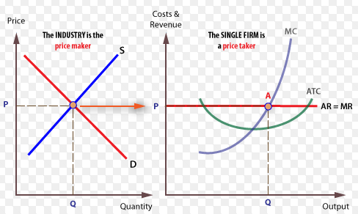
The firm as a ‘price taker’
FIGURE 6.2
Notes:
A firm in a perfectly competitive market is said to be a price taker because the price of the product is determined by market supply and demand, and the individual firm can do nothing to change that price.

Slide 8
Profit-Maximizing Level of Output
Marginal revenue (MR) – the change in total revenue associated with a change in quantity.
Marginal cost (MC) – the change in total cost associated with a change in quantity.

Slide 9
Marginal Revenue
A perfect competitor accepts the market price as given.
As a result, marginal revenue equals price (MR = P).

Slide 10
Marginal Cost
Initially, marginal cost falls and then begins to rise.

Slide 11
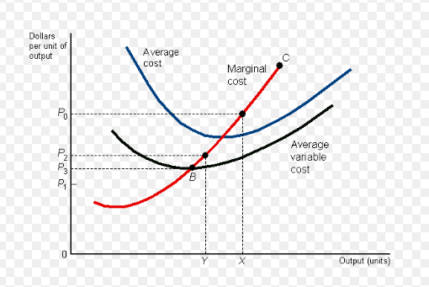
Firm’s short-run supply curve
FIGURE 6.4.
Notes:
In the short-run time period, the firm must at least earn enough revenue to cover total variable costs, thereby making some contributions to the total fixed costs already incurred. In other words price (AR) must be greater than or equal to average variable costs (AVC).
At any price below P1, we have AR<AVC so that TR<TVC. The firm is better off shutting down, since it is not even covering its total variable costs. No output will be supplied in the short run.
At any price above P1, we have AR>AVC so that TR>TVC and the firm is making some contribution to the total costs already incurred. The firm will produce therefore output in the short run.

Slide 12
Firm’s demand curve
Perfectly competitive market structure makes certain predictions as to firm and industry price and output in both short-run and long-run time periods.

Slide 13
Firm’s long-run supply curve
In the long-run period all costs, whether variable or fixed, must be covered, including normal profit often included in cost.
At any price below P2, AR<ATC so that TR<TC and no supply is worthwhile.
At any price above P2, AR>ATC, so that TR>TC and supply is worthwhile.

Slide 14
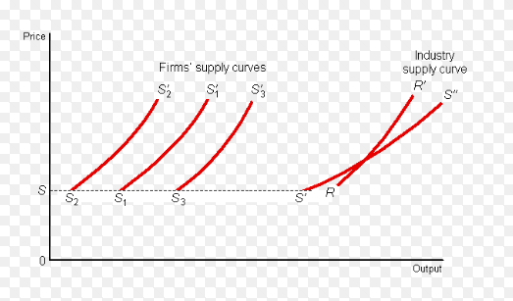
Industry supply curve
Figure 6.5
Notes:
The industry supply curve is the sum of the individual firm MC curves in a competitive industry

Slide 15
Five forces framework and industry’s profitability
Entry heightens competition and reduces the margins of existing firms in a wide variety of industry settings.
Power of Input Suppliers. Industry profits tend to be lower when suppliers have the power to negotiate favorable terms for their inputs.
Power of Buyers. Industry profits tend to be lower when customers or buyers have the power to negotiate favorable terms for the products or services produced in the industry.

Slide 16
Five forces framework and industry’s profitability
Industry Rivalry. Rivalry tends to be less intense (and hence the likelihood of sustaining profits is higher) in concentrated industries—that is, those with relatively few firms.
Substitutes and Complements. The level and sustainability of industry profits also depend on the price and value of interrelated products and services.

Slide 17
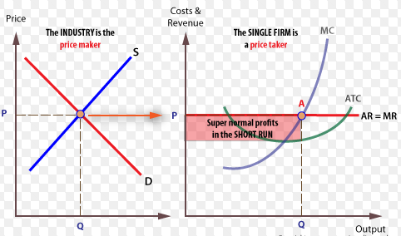
Short-run equilibrium (1)
Figure 6.6.
P=AR=MR=MC
Notes:
In the short-run time period the market (industry) and the firm may earn either above (normal) or below normal (sub-normal) profits.

Slide 18
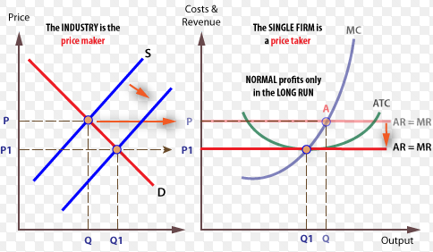
Long-run equilibrium
Figure 6.7
P=AR=MR=MC=ATC
Notes:
Long-run only occur when the price-taking firm faces a perfectly elastic demand curve that just touches to the bottom of its ATC curve. Here, and here only, is the above condition satisfied. The profit maximising firm (MC=MR) is now earning only normal profit (ATC=AR), and no further incentive exists for new firms to enter the industry. We are in long-run equilibrium.
P=AR=MR=MC=ATC

Slide 19
Perfect competition and efficiency (1)
Productive efficiency. To achieve productive efficiency (or cost efficiency) a firm must use its resource in such a way as to produce at the lowest possible cost per unit of output. Therefore, productive efficiency is achieved at the lowest point on a firm’s long-run average total cost curve.

Slide 20
Perfect competition and efficiency (2)
Allocative efficiency. To achieve allocative efficiency it should not be possible to make someone better off by a reallocation of resources without, at the same time, making someone worse off.

Slide 21
Monopoly

Slide 22
Definition of Monopoly
A monopoly is a market structure in which there is a single supplier of a product.
The monopoly firm (monopolist):
May be small or large.
Must be the ONLY supplier of the product.
Sells a product for which there are NO close substitutes.
Monopolies are fairly common: local utility companies, local cable providers, etc.

Slide 23
Types of Monopolies
Natural monopoly: A monopoly that arises from economies of scale. The economies of scale arise from natural supply and demand conditions, and not from government actions.
Local monopoly: a monopoly that exists in a limited geographic area.
Regulated monopoly: a monopoly firm whose behavior is overseen by a government entity.
Monopolistic power: market power, the power to set prices.
Monopolisation: an attempt by a firm to dominate a market or become a monopoly.

Slide 24
Creation of Monopolies
Monopolies often arise as a result of barriers to entry.
Barrier to entry: anything that impedes the ability of firms to begin a new business in an industry in which existing firms are earning positive economic profits.
There are three general classes of barriers to entry:
Natural barriers, the most common being economies of scale
Actions by firms to keep other firms out
Government (legal) barriers

Slide 25
Main Characteristics of Pure Monopoly
Single seller. A pure, or absolute, monopoly is an industry in which a single firm is the sole producer of a specific good or the sole supplier of a service; the firm and the industry are synonymous.
No close substitutes. A pure monopoly’s product is unique in that there are no close substitutes. The consumer who chooses not to buy the monopolized product must do without it.

Slide 26
Main Characteristics of Pure Monopoly
Price maker. The pure monopolist controls the total quantity supplied and thus has considerable control over price; it is a price maker (unlike a pure competitor, which has no such control and therefore is a price taker).
Blocked entry. A pure monopolist has no immediate competitors because certain barriers keep potential competitors from entering the industry. Those barriers may be economic, technological, legal, or of some other type. But entry is totally blocked in pure monopoly.

Slide 27
Main Characteristics of Pure Monopoly
Non-price competition. The product produced by a pure monopolist may be either standardized.
Monopolists that have standardized products engage mainly in public relations advertising whereas those with differentiated products sometimes advertise their products’ attributes.

Slide 28
Legal Barriers to Entry: Patents and Licenses
A patent is the exclusive right of an inventor to use, or to allow another to use, her or his invention.
Patents and patent laws aim to protect the inventor from rivals who would use the invention without having shared in the effort and expense of developing it.
Notes:
The factors that prohibit firms from entering an industry are called barriers to entry. In pure monopoly, strong barriers to entry effectively block all potential competition. Somewhat weaker barriers may permit oligopoly, a
market structure dominated by a few firms. Still weaker barriers may permit the entry of a fairly large number of competing firms giving rise to monopolistic competition.
At the same time, patents provide the inventor with a monopoly position for the life of the patent. The world’s nations have agreed on a uniform patent length of 20 years from the time of application. Patents have figured prominently in the growth of modern-day giants such as IBM, Pfizer, Intel, Xerox, General Electric, and DuPont. Research and development (R&D) is what leads to most patentable inventions and products. Firms that gain
monopoly power through their own research or by purchasing the patents of others can use patents to strengthen their market position. The profit from one patent can finance the research required to develop new patentable products. In the pharmaceutical industry, patents on prescription drugs have produced large monopoly profits that have helped finance the discovery of new patentable medicines. So monopoly power achieved through patents may well be self-sustaining, even though patents eventually expire and generic drugs then compete with the original brand.

Slide 29
Licenses
Government may also limit entry into an industry or occupation through licensing.

Slide 30
Ownership or Control of Essential Resources
A monopolist can use private property as an obstacle to potential rivals.
For example, a firm that owns or controls a resource essential to the production process can prohibit the entry of rival firms.

Slide 31
Pricing and Other Strategic Barriers to Entry
Even if a firm is not protected from entry by, say, extensive economies of scale or ownership of essential resources, entry may effectively be blocked by the way the monopolist responds to attempts by rivals to enter the industry.

Slide 32
Other barriers
Sociological barriers – entry is prevented by custom or tradition.
Natural barriers – the firm has a unique ability to produce what other firms can’t duplicate.
Technological barriers – the size of the market can support only one firm.

Slide 33
Economies of Scale
In some industries, the larger the scale of production, the lower the costs of production.
Entrants are not usually able to enter the market assured of or capable of a very large volume of production and sales.
This gives incumbent firms a significant advantage.
Examples are electric power companies and other similar utility providers.

Slide 34
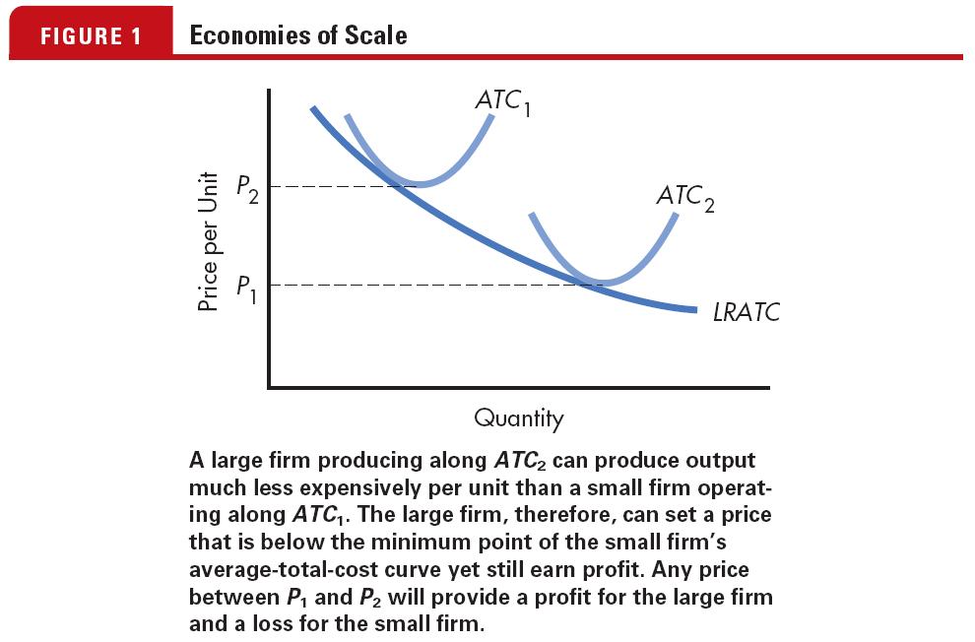
Economies of Scale

Slide 35
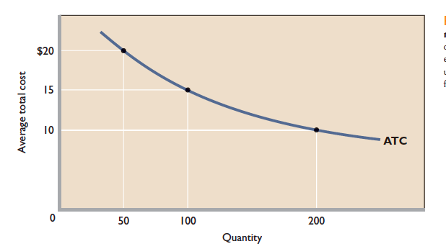
Economies of Scale: Natural monopoly case
Notes:
Economies of scale: the natural monopoly case. A declining long-run average-total-cost curve over a wide range of output quantities indicates extensive economies of scale. A single monopoly firm can produce, say, 200 units of output at lower cost ($10 each) than could two or more firms that had a combined output of 200 units.
In the extreme circumstance, in which the market
demand curve cuts the long-run ATC curve where average
total costs are still declining, the single firm is called
a natural monopoly. It might seem that a natural monopolist’s
lower unit cost would enable it to charge a lower price
than if the industry were more competitive. But that won’t
necessarily happen. As
with any monopolist, a
natural monopolist may,
instead, set its price far
above ATC and obtain
substantial economic profit. In that event, the lowest-unitcost
advantage of a natural monopolist would accrue to the
monopolist as profit and not as lower prices to consumers.
That is why the government regulates some natural
monopolies, specifying the price they may charge.

Slide 36
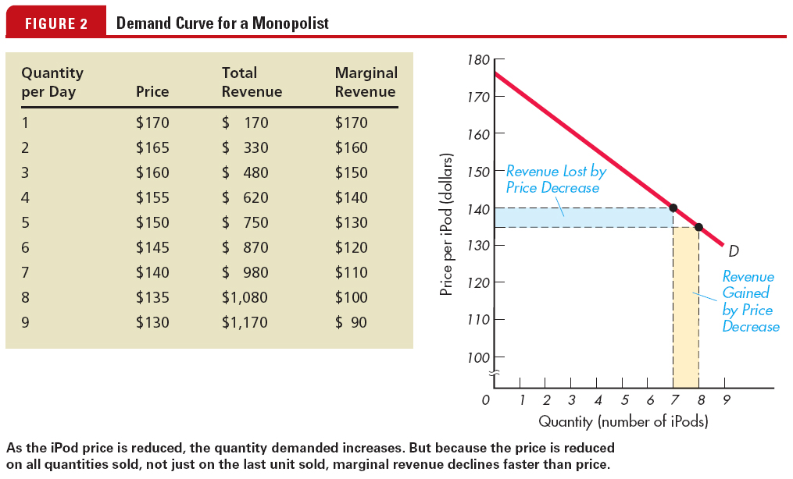
Demand Curve for Monopoly Firm

Slide 37
Price under perfect competition and monopoly
The crucial difference between a pure monopolist and a purely competitive seller lies on the demand side of the market.
The purely competitive seller faces a perfectly elastic demand at the price determined by market supply and demand. It is a price taker that can sell as much or as little as it wants at the going market price. Each additional unit sold will add the amount of the constant product priceto the firm’s total revenue.
Notes:
That means that marginal revenue
for the competitive seller is constant and equal to
product price. (Refer to Table 9.2 and Figure 9.1 for price,
marginal-revenue, and total-revenue relationships for the
purely competitive firm.)

Slide 38
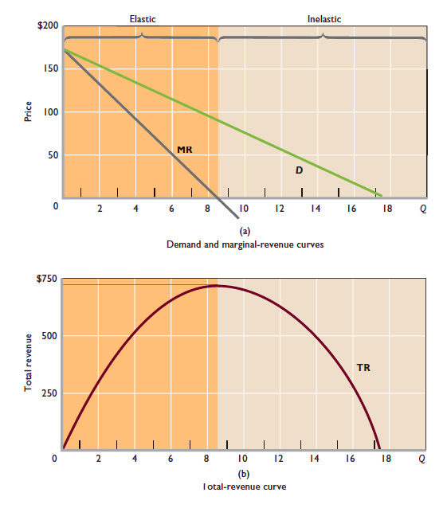
Demand, marginal revenue, and total revenue for a pure monopolist
Notes:
(a) Because it must lower price on all units sold in order to increase its sales, an imperfectly competitive firm’s marginal-revenue curve (MR) lies below its downsloping demand
curve ( D ). The elastic and inelastic regions of demand are highlighted. (b) Total revenue (TR) increases at a decreasing rate, reaches a maximum, and then declines. Note that in the elastic region, TR is increasing and hence MR is positive. When TR reaches its maximum, MR is zero. In the inelastic region of demand, TR is declining, so MR is negative.

Slide 39
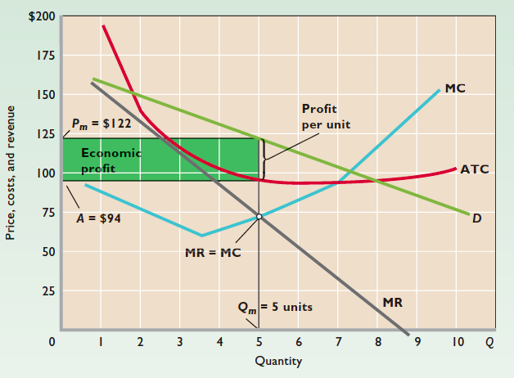
Equilibrium price and output
Notes:
A monopolist seeking to maximize total profit will employ
the same rationale as a profit-seeking firm in a competitive
industry. If producing is preferable to shutting down,
it will produce up to the output at which marginal revenue
equals marginal cost (MR MC)
Profit maximization by a pure
monopolist. The pure monopolist maximizes profit by
producing at the MR MC output, here Qm 5 units. Then,
as seen from the demand curve, it will charge price Pm
$122. Average total cost will be A $94, meaning that perunit
profit is Pm A and total profit is 5 (Pm A). Total
economic profit is thus represented by the green rectangle.

Slide 40
Profit Maximization for a Monopolist

Slide 41
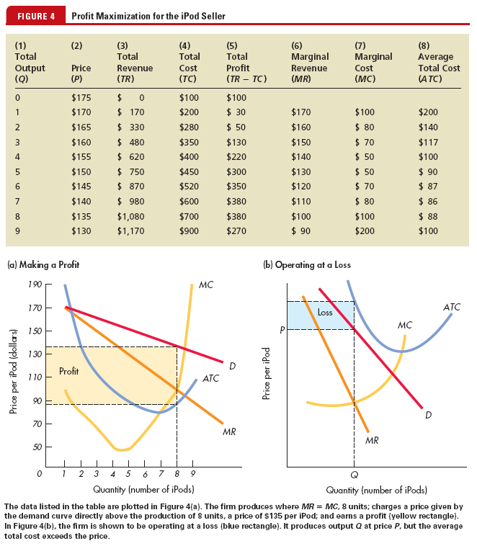
Profit Maximization

Slide 42
MR = MC Determines the Profit-Maximizing Output
If MR > MC, the monopolist gains profit by increasing output.
If MR < MC, the monopolist gains profit by decreasing output.
If MC = MR, the monopolist is maximizing profit.

Slide 43
Profit Maximization

Slide 44
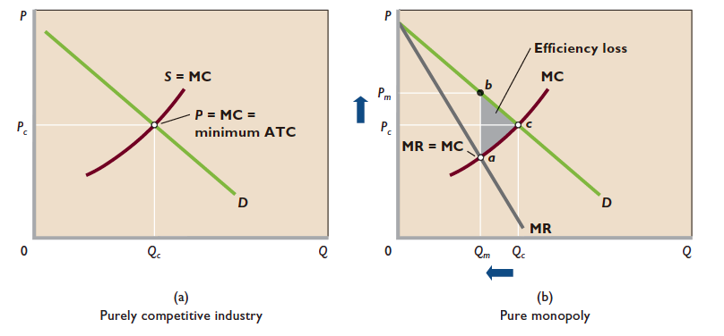
Inefficiency of pure monopoly relative to a purely competitive industry
Notes:
(a) In a purely
competitive industry, entry and exit of firms ensure that price (Pc) equals marginal cost (MC) and that the minimum averagetotal-
cost output (Qc) is produced. Both productive efficiency (P minimum ATC) and allocative efficiency (P MC) are
obtained. (b) In pure monopoly, the MR curve lies below the demand curve. The monopolist maximizes profit at output Qm, where
MR MC, and charges price Pm.Thus, output is lower (Qm rather than Qc) and price is higher (Pm rather than Pc) than they would
be in a purely competitive industry. Monopoly is inefficient, since output is less than that required for achieving minimum ATC
(here at Qc) and because the monopolist’s price exceeds MC. Monopoly creates an efficiency loss (here of area abc)

Slide 45
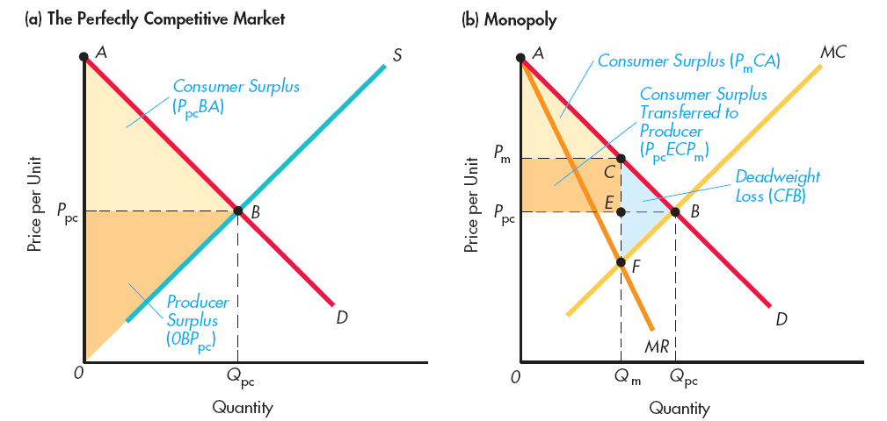
Perfect Competition and Monopoly Compared

Slide 46
Price Discrimination
Price discrimination can take three forms:
Charging each customer in a single market the maximum price she or he is willing to pay.
Charging each customer one price for the first set of units purchased and a lower price for subsequent units purchased.
Charging some customers one price and other customers another price.
Notes:
We have assumed in this chapter that the monopolist charges a single price to all buyers. But under certain conditions the monopolist can increase its profit by charging different prices to different buyers. In so doing, the monopolist is engaging in price discrimination , the practice of selling a specific product at more than one price when the price differences are not justified by cost differences.

Slide 47
Conditions for Price Discrimination
Monopoly power. The seller must be a monopolist or, at least, must possess some degree of monopoly power, that is, some ability to control output and price.
Market segregation. At relatively low cost to itself, the seller must be able to segregate buyers into distinct classes, each of which has a different willingness or ability to pay for the product. This separation of buyers is usually based on different price elasticities of demand, as the examples below will make clear.

Slide 48
Conditions for Price Discrimination
No resale. The original purchaser cannot resell the product or service. If buyers in the low-price segment of the market could easily resell in the high-price segment, the monopolist’s price discrimination strategy would create competition in the high-price segment.

Slide 49
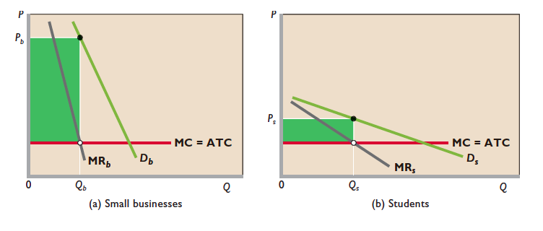
Price Discrimination

Slide 50
Price discrimination to different groups of buyers
The price-discriminating monopolist represented here maximizes its total profit by dividing the market into two segments based on differences in elasticity of demand.
It then produces and sells the MR MC output in each market segment. (For visual clarity, average total cost (ATC) is assumed to be constant.
Therefore MC equals ATC at all output levels.) (a) The firm charges a higher price (here, Pb) to customers who have a less elastic demand curve and (b) a lower price (here, Ps) to customers with a more elastic demand.
The price discriminator’s total profit is larger than it would be with no discrimination and therefore a single price.

Slide 51
Monopolistic Competition
monopolistic competition is characterized by (1) a relatively large number of sellers, (2) differentiated products (often promoted by heavy advertising), and (3) easy entry to, and exit from, the industry.

Slide 52
Relatively Large Number of Sellers
Small market shares. Each firm has a comparatively small percentage of the total market and consequently has limited control over market price.
No collusion. The presence of a relatively large number of firms ensures that collusion by a group of firms to restrict output and set prices is unlikely.
Independent action. With numerous firms in an industry, there is no feeling of interdependence among them; each firm can determine its own pricing policy without considering the possible reactions of rival firms. ably trigger no response.

Slide 53
Differentiated Products
Product differentiation may entail physical or qualitative differences in the products themselves.
Differentiation by:
Location
Brand names and packing
Services
Some control over prices

Slide 54
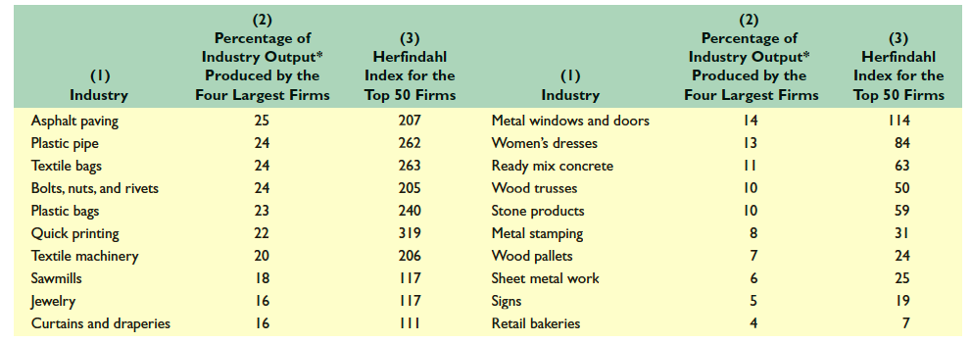
Percentage of Output Produced by Firms in Selected Low-Concentration U.S. Manufacturing Industries

Slide 55
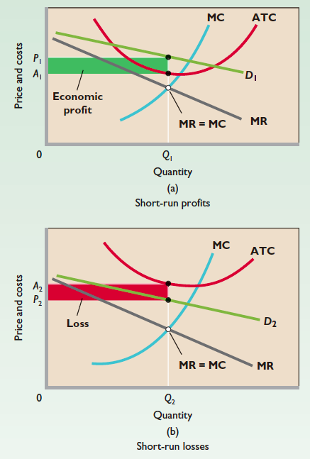
A monopolistically competitive firm: short run

Slide 56
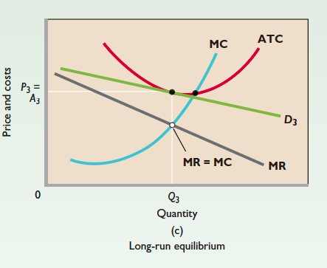
A monopolistically competitive firm: long run

Slide 57
Oligopoly

Slide 58
Characteristics of Oligopoly
An oligopoly is a market structure characterized by:
Few firms
Either standardized or differentiated products
Difficult entry
Oligopolies are made up of a small number of mutually interdependent firms.
Each firm must take into account the expected reaction of other firms.

Slide 59
Oligopoly
Oligopoly refers to a situation in which a few firms dominate in the market. Crucially these firms few firms recognize their rivalry and interdependence, fully aware that any action on their part is likely to result counter-actions by their rivals.

Slide 60
Entry Barriers
The same barriers to entry that create pure monopoly also contribute to the creation of oligopoly.
Economies of scale are important entry barriers in a number of oligopolistic industries, such as the aircraft, rubber, and copper industries.

Slide 61
Non-collusive oligopoly
Here firm compete each other using strategies and counter strategies, but do not seek to make agreements, whether formal or informal, to ‘fix’ the market outcomes.

Slide 62
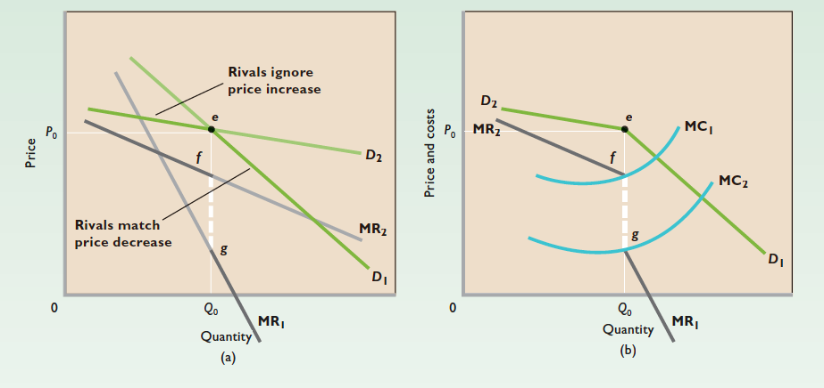
Kinked Demand Curve (1)

Slide 63
Kinked Demand Curve (2)
If the firm were to raise its price above the current level, its rivals would not follow, content to let firm lose sales to them.
If the firm were to reduce its price, rivals would follow to protect their market share, so that the firm gains extra sales.

Slide 64
Three Oligopoly Models
Diversity of oligopolies. Oligopoly encompasses a greater range and diversity of market situations than do other market structures.
Complications of interdependence. The mutual interdependence of oligopolistic firms complicates matters significantly. Because firms cannot predict the reactions of their rivals with certainty, they cannot estimate their own demand and marginal-revenue data.

Slide 65
Game theory
Strategic behavior has been analyzed using the mathematical techniques of game theory.
Game theory provides a description of oligopolistic behavior as a series of strategic moves and countermoves.

Slide 66
Game Theory and Strategic Decision Making
The prisoner’s dilemma is a well-known game that demonstrates the difficulty of cooperative behavior in certain circumstances.

Slide 67
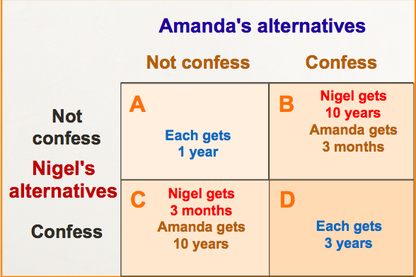
The prisoners' dilemma

Slide 68
Game Theory and Strategic Decision Making
In the prisoner’s dilemma, where mutual trust gets each one out of the dilemma, confessing is the rational choice.

Slide 69
Prisoner’s Dilemma and a Duopoly Example
The prisoners dilemma has its simplest application when the oligopoly consists of only two firms—a duopoly.

Slide 70
Prisoner’s Dilemma and a Duopoly Example
By analyzing the strategies of both firms under all situations, all possibilities are placed in a payoff matrix.
A payoff matrix is a box that contains the outcomes of a strategic game under various circumstances.

Slide 71
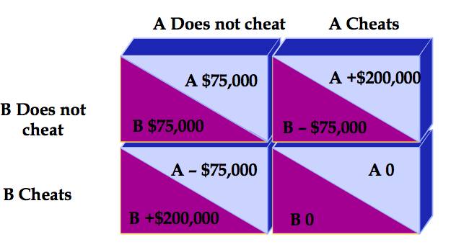
The Payoff Matrix of Strategic Pricing Duopoly

Slide 72
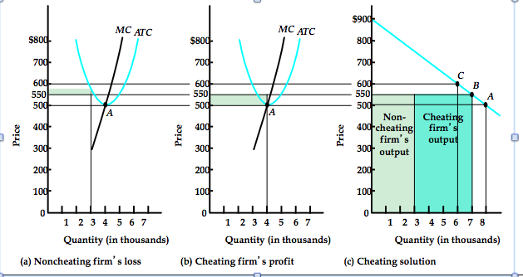
Firm and Industry Duopoly Equilibrium When One Firm Cheats

Slide 73
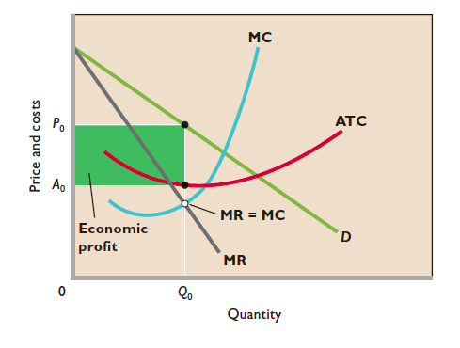
Collusion and the tendency toward joint-profit maximization
Notes:
If oligopolistic firms face identical or highly
similar demand and cost conditions, they may collude to limit their joint
output and to set a single, common price. Thus each firm acts as if it were
a pure monopolist, setting output at Q0 and charging price P0 . This price
and output combination maximizes each oligopolist’s profit (green area)
and thus the combined or joint profit of both.

Slide 74
Formal Collusion: Cartels
Cartels involves establishing and maintaining some kind of organizations which seek to direct policy of its members to reach some agreed end. For example OPEC (Oil Producing and Exporting Countries)
Notes:
Attempts to set prices high enough to earn member countries significant profits, but not so high as to encourage dramatic increases in oil exploration or the pursuit of alternative energy sources.
Controls prices by setting production quotas for member countries.
Such cartels are difficult to sustain because members have large incentives to cheat, exceeding their quotas.

Slide 75
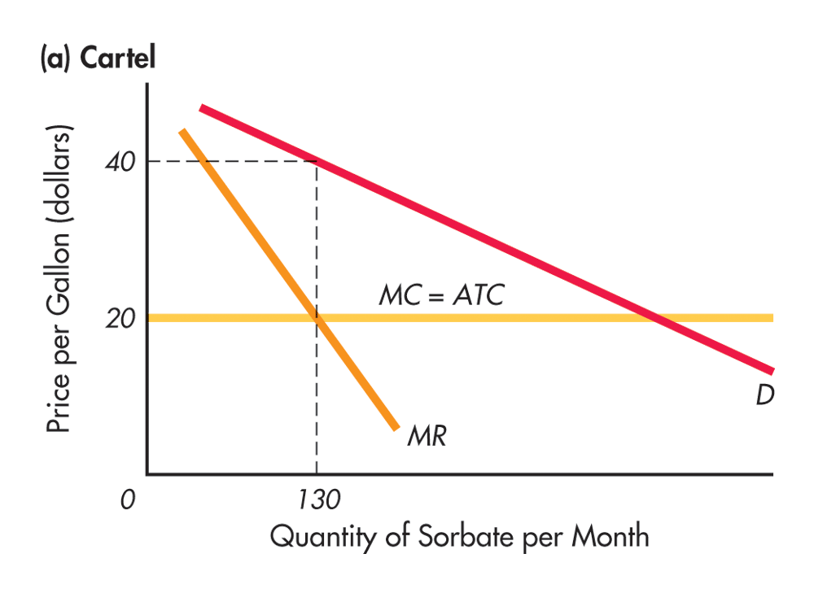
Behavior of a Cartel: Firms Agree to Act as a Monopolist

Slide 76
Informal collusion
Dominant firm price leadership
Barometric price leadership
Collusive price leadership

Slide 77
Thank you!

Slide 78
Key terms (1)
Barometric-firm leadership. Here the price leader is a small form, recognized by others as having a close knowledge of prevailing market conditions.
Barriers to entry. Various deterrents to new firms to enter into a market.
Collusive price leadership. Where a group of often large firms set similar prices for their product but where no ‘formal collusion’ (e.g. cartel) exists.
Contestable markets. Markets in which the threat of new firm entry causes incumbents to act as though such potential competition actually existed.

Slide 79
Key terms (2)
Dominant-price leadership. Where the prices set by a single, usually dominant, firm in the market are followed by other smaller firms.
Dominant strategy. One in which the respective firms seek to do the best they can in terms of the objectives set, irrespective of the possible actions/ reactions of any rival(s).
Limit price. The highest price which the established firms believe they can charge without attracting new entry.
Long-run. Period of time in which all factors of production can be varied.

Slide 80
Key terms (3)
Maxi-min. An approach in game theory whereby each firm selects the worst of the best possible outcomes identified in a pay-off matrix.
Monopolistic competition. A market structure which contains elements of both monopoly and competitive market forms. Differentiated products give firms an element of market power, but the existence of large numbers of relatively small firms, with freedom of entry/ exit, provide an element of competition.
Monopoly where over 25% of the output of a product is in the hands of a single firm or group of linked firms.

Slide 81
Key terms (4)
Nash equilibrium occurs when each form is doing the best that it can in terms of its own objectives, given the strategies chosen by the other firms in the market.
Natural monopoly situation where the minimum efficient size of the productive unit or enterprise is so large that the industry can sustain only a single operator.
Normal profit that profit just sufficient to keep the firm in the industry in the long run.
Oligopoly a market dominated by a few large firms and in which their interdependence is recognized by those firms.
Pareto optimal a resource allocation for which it is no longer possible to make anyone better off without making someone else worse off.

Slide 82
Key terms (5)
Perfect competition. A market in which there are a large number of small firms producing an identical product and in which there is freedom of entry and exit.
Perfectly contestable market. Situation in which no barriers to entry exist so that incumbent firms are constrained by the threat of new firm entry to keep prices at levels that, in relation to costs, earn only normal profits.
Price discrimination. Situation in which different prices are charged for identical units of a product.
Price leadership where firms tend to respond, when setting their own prices already set by one or more other firms in industry.

Slide 83
Key terms (6)
Pure monopoly. A single supplier of the product.
Short-run. Period of time in which at least one factor of production is fixed.
Stable-equilibrium. Situation in which any movement away from an equilibrium initiates changes that move the situation back towards that equilibrium.
Zero-sum game. A game in which a gain for one or more players is offset by an equivalent loss for some other players.

